Slide 1



Slide 2
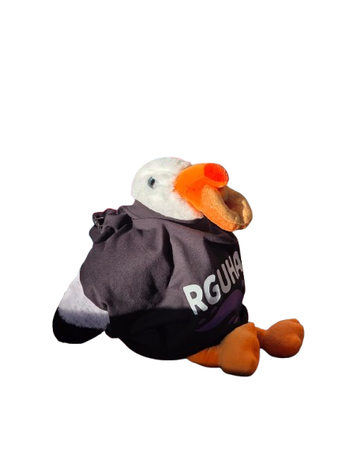
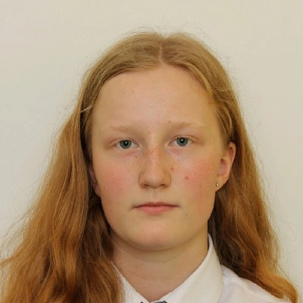
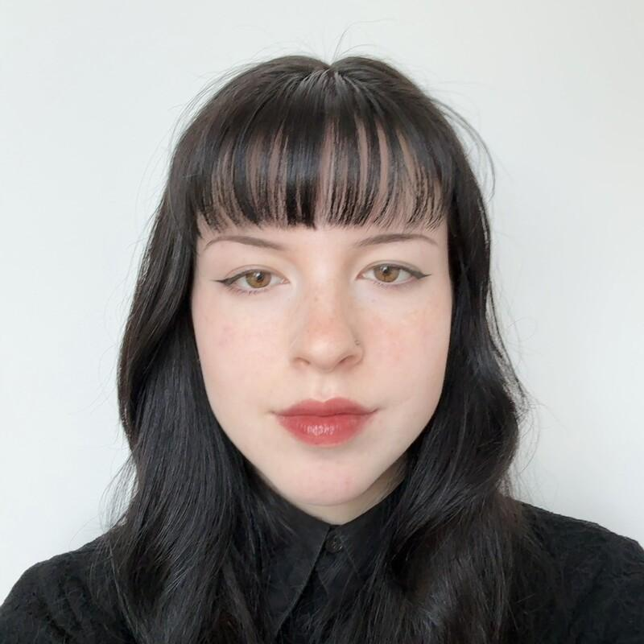
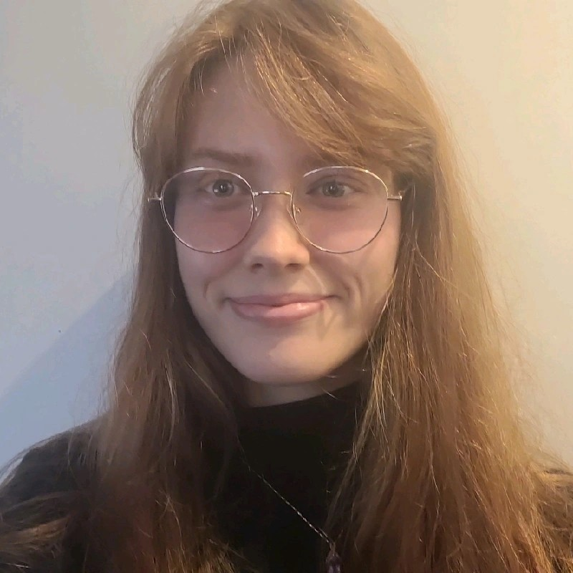
@Alexandra Crichton
@Audrey Stark
#BirdBrainz on Linkedin
@Niamh Isla Murphy

Slide 3



Visual
Social
Simple

Slide 4

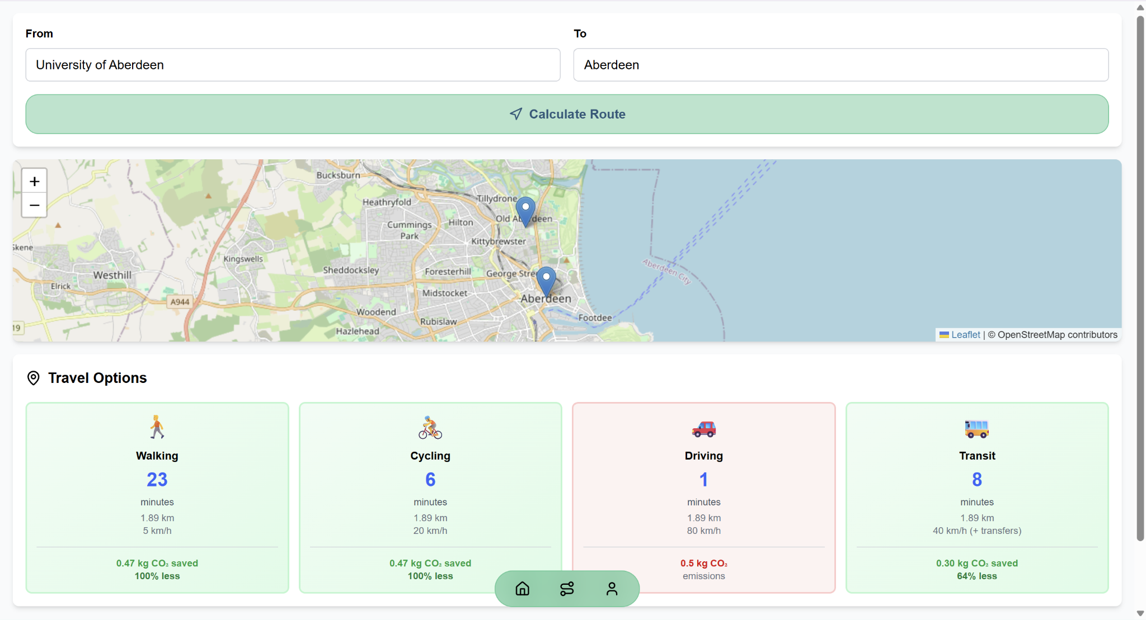
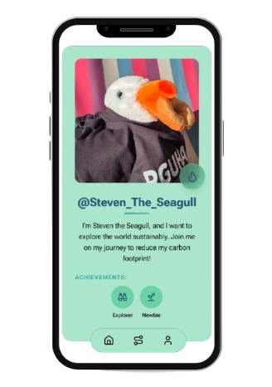
Demo!

Slide 5





Pick Routes
Get Points
Make Friends

Slide 6
Be like Steven.
Be a sustainable superstar!

